Slide 1
The Price is Right
Robert, Javier, Deshawn, Stephan, Trang

Slide 2
Introduction of our version
The price is right
  Online game for multiplayers.
  Allow players to win “prizes” by guessing price of merchandises.
  Only chosen players actually have chance to win “prizes” although everyone can join game.
  Rule of thumb: Never Go Over.
  There are two rounds:
    Preliminary round
    Tournament round

Slide 3
Rule of play
Preliminary round: (3 games)
  There are 5 contestants.
  Once item/merchandise is shown, each contestant has turn to place a single bid on the initial prize. The bid has to be different to others.
  The winner is the one who bids closest to the actual retail price without going over it.
  Winner of each game will enter to tournament round.
  We will pick another contestant from audience to replace for winner spot????(or total brand new 5 contestant???)==> Fix This pls. I’m not sure

Slide 4
2. Tournament round
  The three contestants from preliminary round’s winner , each has to spin the wheel once and then optionally a second time.
  Again, whose total score closest to $1.00 without going over is our final winner.
  Any contestant who scores exactly $1.00, either on the first spin or as a total from two spins, wins an extra $1,000 .

Slide 5
For the user
Installation
Set up:
Get the source code from
https://github.com/broncostooge/CPSC473Project2
Run the app:
1.- Type in Terminal: npm install to install all of the dependencies
$ npm install
2.- Run Web Api and app
$ node server.js
3.- Access
Go to browser and type localhost:3000

Slide 6
Tools we use
Node.js
Express.js
Body-parser
MongoDB
Redis
socket.io
Knockout

Slide 7
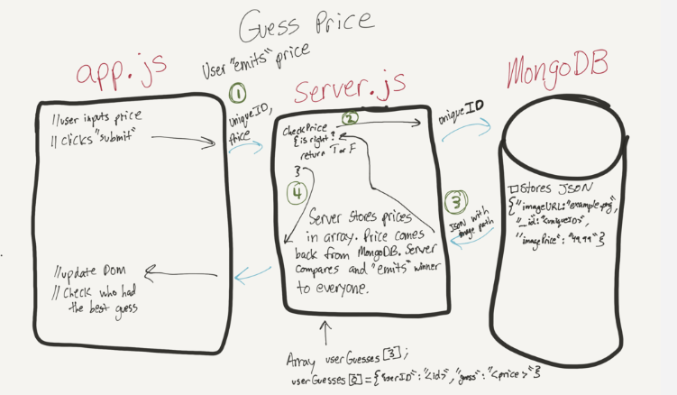
Meet the requirements
Real time interaction
MVC modelRobert, Javier, Deshawn, Stephan, Trang
Robert, Javier, Deshawn, Stephan, Tr

